Slide 1

Project 3: Classification modelling
Done By: Jamie
Class: DSI14

Slide 2
Problem Statement
Discussions on Reddit are organized into user-created areas of interest called "subreddits". There are about 138,000 active subreddits among a total of 1.2 million, as of July 2018. As the amount of subreddits will continue to grow, we would like build a classifier model to help identify posts from different subbredits and guide user traffic to the appropiate subbredit.
Notes:
Gdojpdojgk[okgd[fk

Slide 3
Work Flow
Data Collection
Data Cleaning
Exploratory Data Analysis
Modelling
Preprocessing
Choose and fit models
Model Improvements
Results and Evalution
Conclusion and Recommedations

Slide 4

Data Collection
r/Romance
I picked the 2 subbreddits on romance and relationships as they are both similar in topics and to see if the classifier is capable of differentiating between these 2 subreddits.
r/Relationships

Slide 5
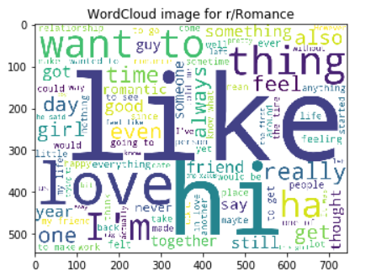
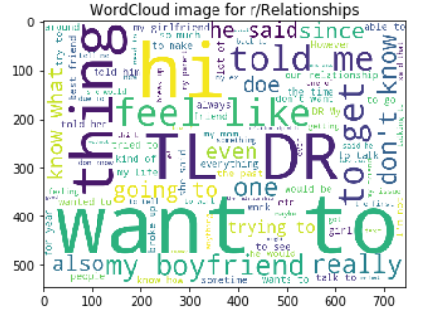
EDA – Word Cloud
Common words such as "hi" and "thing".
'TL DR' which stands for 'too long, didn't read’
Add those words to Stop Word list

Slide 6
Cleaning & processing of words
Remove the non-letters
Covert words to lowercase
Remove stop words including the ones that I have added
Run the words in tokenizer

Slide 7
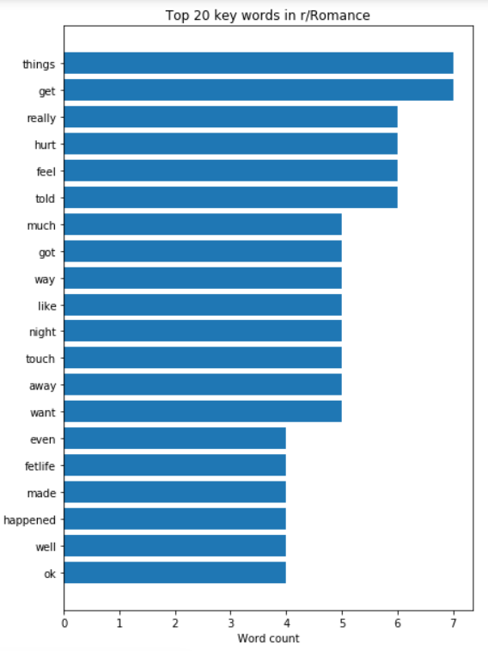
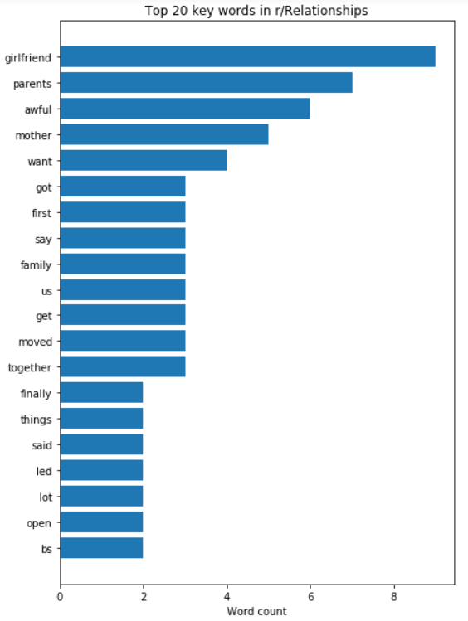
Comparison of Top 20 Key words

Slide 8
Labels & Baseline score
Romance -> 0
Relationships -> 1
Labels | Baseline Score
1 | 0.514451
0 | 0.485549

Slide 9

CountVectorizer
Transform the word counts into a matrix
To be fitted using a model

Slide 10
Models
Naive Bayes Multinomial Model
Model score on X_train = 0.8766
Model score on X_test = 0.8508
Logistic Regression Model
Model score on X_train = 0.9992
Model score on X_test = 0.9243

Slide 11

Finding the best model - GridSearchCV
Using the best hyper-parameters:
Logistic Regression Model
Previous score on X_test = 0.9243
Best score on X_test = 0.9496
Naive Bayes Multinomial Model
Previous score on X_test= 0.8508
Best score on X_test = 0.8592

Slide 12
Results and Evaluation
Our best model is Logistic Regression which returns an accuracy score of 0.949. This means it is able to accurately predict 92.4% the correct subbredit of the post.
We have a high value of 0.9495 for Receiver Operating Characteristic Area under the ROC Curve (ROC AUC).
If we have a ROC AUC of 1, our positive and negative populations are perfectly separated.

Slide 13
Conclusion and Recommendations
My model has a 94.96% chance to correctly predict that the post originate from the correct subreddit.
Recommendations to further improve the model:
Removing more stop words may help to further increase the accuracy of the model
Lemmatizing or stemmatizing words so that same type of words such as “get", “got" will be counted as the same word. However, in this project, i have tested and the accuracy score was actually worse. Hence, it may work on a case-to-case basis
Increasing the use number of n-grams from 2-3 words to 4-5 words
Using Term Frequency-Inverse Document Frequency (TF-IDF) Vectorizer will help to penalize words that appear frequently giving more weightage to words that appear less frequently between the documents

Slide 14

End of Presentation Q n A

